Slide 1

Is there a need for centralized data repository in the iSchool?
Group 7: Ishita Bhandari, Prakirn Kumar, Sejal Khatri, Yanjie Niu

Slide 2
Introduction
Methodologies
Findings and Analysis
Recommendations
Future Direction

Slide 3
Introduction

Slide 4


MOTIVATION
Clueless as new researchers in iSchool.
Universities joining the Open Data Movement.
SIGNIFICANCE
Helpful for decision makers.
Groundwork for future studies.

Slide 5




AIM
To analyze the need of a centralized data repository which serves as a unifying platform for publishing and sharing data related to the research and other academic activities going on in the iSchool.
Source: www.flaticon.com

Slide 6

SPECIFIC OBJECTIVES
To identify if there’s a need of a centralized data.
To explore people’s reasoning.
To obtain exact needs and expectations.
To check the feasibility.
To provide meaningful recommendations.

Slide 7
Methodologies

Slide 8



Research Question Investigation
Secondary Literature Research:
Secondary literature on open data movement, open data repository, and data governance.
Primary Research Methods:
Interviews and Surveys

Slide 9

Sampling Methods
Snowball Sampling
Purposeful Sampling
Quota Sampling

Slide 10
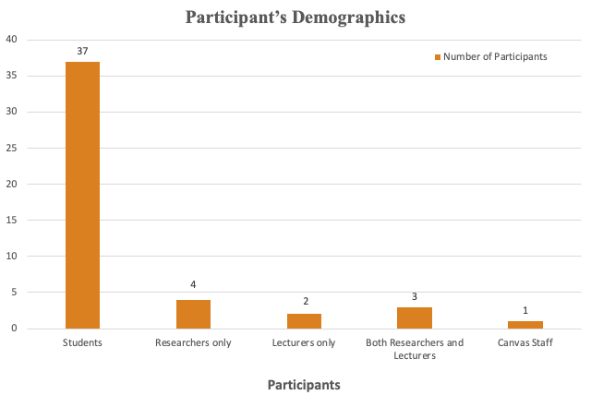
Data Collection
Mixed Approach
Qualitative Data Collection
Interviews
11 Participants
Quantitative Data Collection
Surveys
37 Responses

Slide 11

Ethical Consideration
Maintaining anonymity of our interviewee’s responses.
Respecting privacy of our respondents
Refraining from introducing our bais into the analysis.
Being mindful of our research consequences

Slide 12
Findings and Analysis

Slide 13


FINDINGS & ANALYSIS
SURVEYS
INTERVIEWS

Slide 14
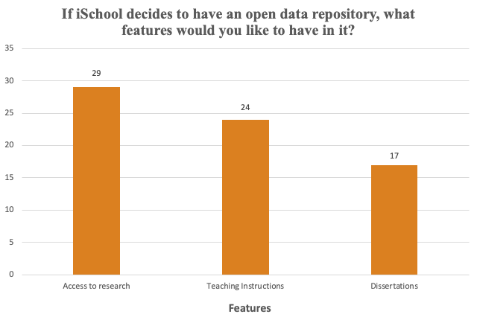
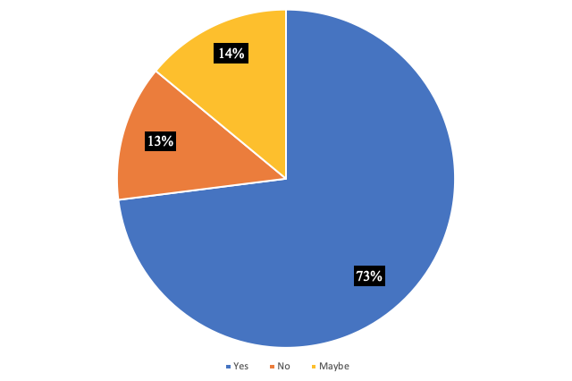
Quantitative Analysis
Features in the iSchool’s Data Repository
Willingness to share data on
iSchool’s Data Repository

Slide 15
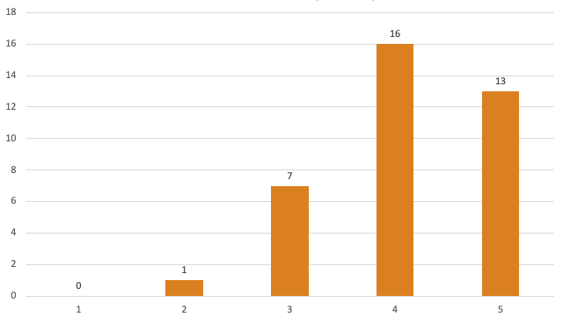
Quantitative Analysis
Rating of usefulness of
having such data repository
for the iSchool

Slide 16
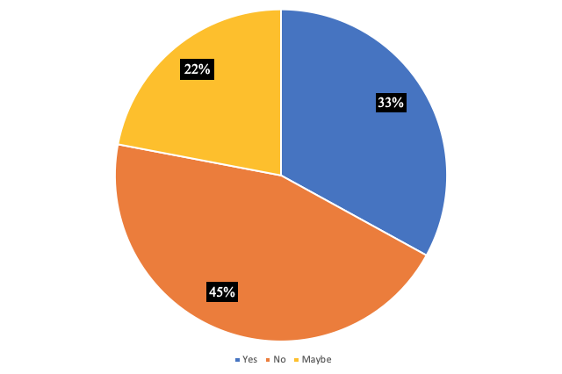
Qualitative Analysis
Willingness to share data on
iSchool’s Data Repository
Lecturers
No need for the repository.
Satisfied by the functionalities provided by Canvas.
Researchers and PhD students
4/7 participants are willing to share their data.
No Persistent portal exists for putting extra datasets for students.
Discipline based data portal exists but not institutional based like iSchool data portal
Data generated from interviews is hard to anonymize and can lose context

Slide 17

CONCLUSION
Students feel having such Data Portal is:
Lecturers & Researchers feel having such Data Portal is:
HELPFUL & NEEDED
HELPFUL but
NOT NEEDED

Slide 18
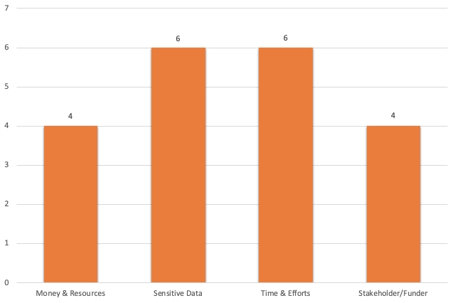
CONCERNS
Additional Efforts
Maintenance of repository
Stakeholders
Data Sensitivity
Copyright

Slide 19
Recommendations

Slide 20

RECOMMENDATIONS
1. Identify Students’ Needs (3 months).
More interviews and focus groups
Students Faculty Members and PhD researchers
Reasons:
In our surveys, iSchool students indicate their need.
Six teaching faculties are willing to share.

Slide 21


RECOMMENDATIONS
2. Adjust Data Management Portal Plan, Based
on Methodologies.
Quantitative Study: Labs and Normalized data-sharing,
(3 months) * Recruit more students.
* A newsletter.
Qualitative Study:
(2 years pilot tests)
Research Ecosystem

Slide 22

RECOMMENDATIONS
3. Promote the Implementation of Data Portal at the University Level through Departments Collaboration (3 years).
Platform
Data portal organizational structure
Decentralized United Data Portal at UW.
IT Staff at iSchool & UW, long-term collaboration.
Impacts:
Cost-Effective
More Data Provider
More Data Receivers

Slide 23
Future Direction

Slide 24

FUTURE ACTIONS OF THIS STUDY
Technically:
Manually Accountable Algorithms and Softwares
Things to explore:
Microdata & metadata, re-identification.
Integrated legal-technical approach:
A third-party data trust
Things to explore:
Selection of a third-party data trust, new laws.

Slide 25

Thank you!
Q & A

